Slide 1


Slide 2

Describe contemporary organizational designs
Discuss how organizations organize for collaboration
Explain flexible work arrangements used by organizations
Discuss organizing issues associated with a contingent workforce
Describe today’s organizational design challenges

Slide 3
Contemporary Organizational Designs
Team Structure - an organizational structure in which the entire organization is made up of work teams
Matrix Structure - an organizational structure that assigns specialists from different functional departments to work on one or more projects

Slide 4
Contemporary Organizational Designs (cont.)
Project Structure - an organizational structure in which employees continuously work on projects
Boundaryless Organization - an organization whose design is not defined by, or limited to, the horizontal, vertical, or external boundaries imposed by a predefined structure

Slide 5
Contemporary Organizational Designs (cont.)
Virtual Organization - an organization that consists of a small core of full-time employees and outside specialists temporarily hired as needed to work on projects.
Network Organization - an organization that uses its own employees to do some work activities and networks of outside suppliers to provide other needed product components or work processes.

Slide 6
Contemporary Organizational Designs (cont.)
Learning Organization - an organization that has developed the capacity to continuously learn, adapt, and change

Slide 7
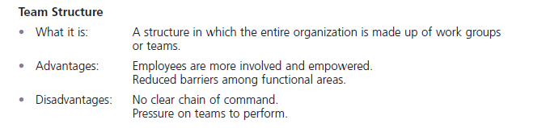
Exhibit 11-1: Contemporary Organizational Designs
Notes:
Organizations need to be lean, flexible, and innovative; that is, they need to be more organic. So managers are finding creative ways to structure and organize work. These contemporary designs include team structures, matrix and project structures, boundaryless organizations, and learning organizations. (See Exhibit 11-1 for a summary of these designs.)

Slide 8
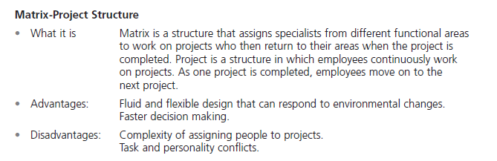
Exhibit 11-1: Contemporary Organizational Designs (cont.)

Slide 9
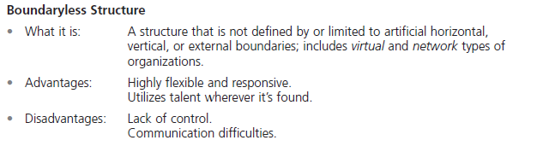
Exhibit 11-1: Contemporary Organizational Designs (cont.)

Slide 10
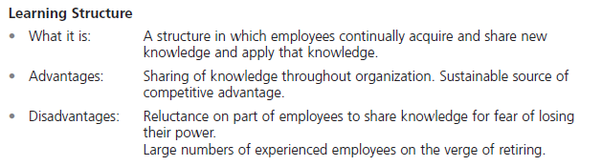
Exhibit 11-1: Contemporary Organizational Designs (cont.)

Slide 11
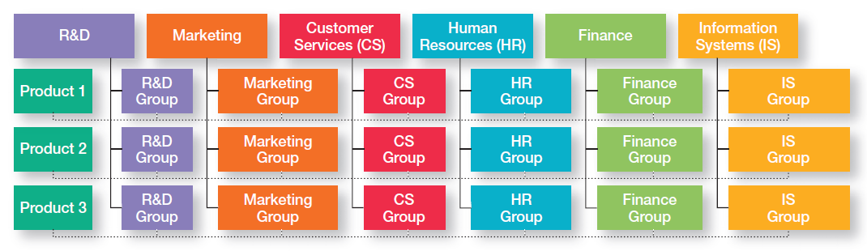
Exhibit 11-2: Example of a Matrix Organization
Notes:
Other popular contemporary designs are the matrix and project structures. The matrix structure assigns specialists from different functional departments to work on projects being led by a project manager. (See Exhibit 11-2.)

Slide 12
Internal Collaboration
Cross-functional team - a work team composed of individuals from various functional specialties.
Task force (or ad hoc committee) - a temporary committee or team formed to tackle a specific short-term problem affecting several departments.

Slide 13
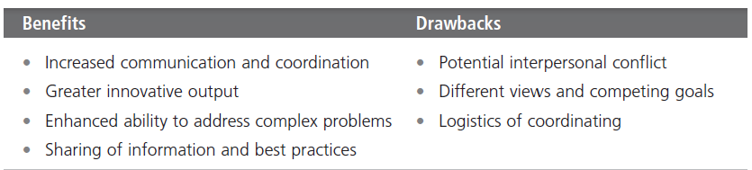
Exhibit 11-3: Benefits and Drawbacks of Collaborative Work
Notes:
employees. Exhibit 11-3 lists some of the benefits and drawbacks of working collaboratively. An organization’s collaboration efforts
can be internal—that is, among employees within the organization. Or those efforts can be external collaborations with any stakeholders

Slide 14
Internal Collaboration (cont.)
Communities of practice - groups of people who share a concern, a set of problems, or a passion about a topic, and who deepen their knowledge and expertise in that area by interacting on an ongoing basis.

Slide 15
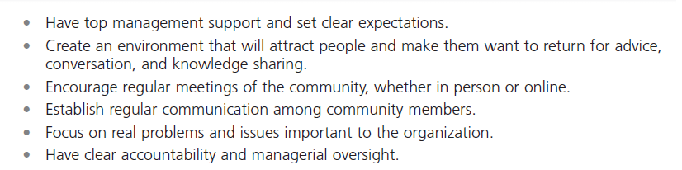
Exhibit 11-4: Making Communities of Practice Work
Notes:
A recent research study found that communities of practice can “create value by contributing to increased effectiveness in employees’ job performance through greater access that they provide to the ideas, knowledge, and best practices shared among community members.” Exhibit 11-4 lists some suggestions for making such communities work.

Slide 16
External Collaboration
Open innovation - opening up the search for new ideas beyond the organization’s boundaries and allowing innovations to easily transfer inward and outward.
Strategic partnerships - collaborative relationships between two or more organizations in which they combine their resources and capabilities for some business purpose.

Slide 17
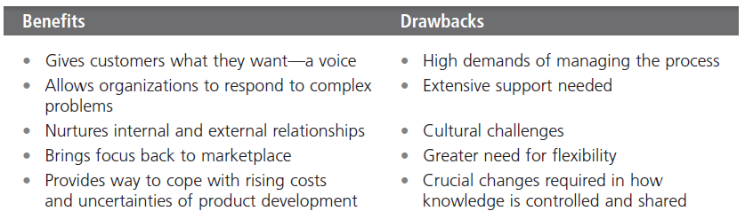
Exhibit 11-5: Benefits and Drawbacks of Open Innovation
Notes:
Many of today’s successful companies are collaborating directly with customers in the product development process. Others are partnering with suppliers, other outsiders, and even competitors. Exhibit 11-5 describes some of the benefits and drawbacks of open innovation.

Slide 18

Flexible Work Arrangements
Telecommuting - a work arrangement in which employees work at home and are linked to the workplace by computer.

Slide 19

Flexible Work Arrangements (cont.)
Compressed workweek - a workweek where employees work longer hours per day but fewer days per week

Slide 20
Flexible Work Arrangements (cont.)
Flextime (or flexible work hours) - a scheduling system in which employees are required to work a specific number of hours a week but are free to vary those hours within certain limits.
Job sharing - the practice of having two or more people split a full-time job.

Slide 21
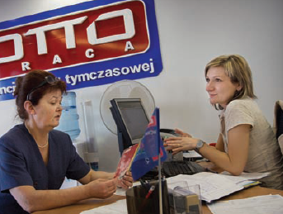
Contingent Workforce
Contingent workers - temporary, freelance, or contract workers whose employment is contingent upon demand for their services.

Slide 22
Terms to Know
Team structure
Matrix structure
Project structure
Boundary less organization
Virtual organization
Network organization
Learning organization
Cross-functional team
Task force (or ad hoc committee)
Communities of practice
Open innovation
Strategic partnerships
Telecommuting
Compressed workweek
Flextime (or flexible work hours)
Job sharing
Contingent workers
Notes:
22

